Slide 1



2
Trading Vision Project (TVP)
PRESENTED BY
20107793 - Han Ngo Gia
20107788 - Nguyen Nguyen Bao
20107785 - Minh Quach Hoang
20108272 - Thu Nguyen Vu Anh
SUPERVISOR
Ms. Le Thi Nhan

Slide 2
Table of Contents
1
2
1
Context
Plan
3
4
Tasks
Evaluation

Slide 3

Context

Slide 4
Context
3
The customers have a budget, and they want to invest in the Vietnamese stock market. They would like to have a web application to update stock trends.
The customers would like the application to have overview page, chart page, reminder, favorite list page and user information page.
🔶 The main requirement is the website should also give the auto trend prediction in the next 5 days.

Slide 5

4
Plan
Plan
Completed Tasks
Remaining Tasks

Slide 6
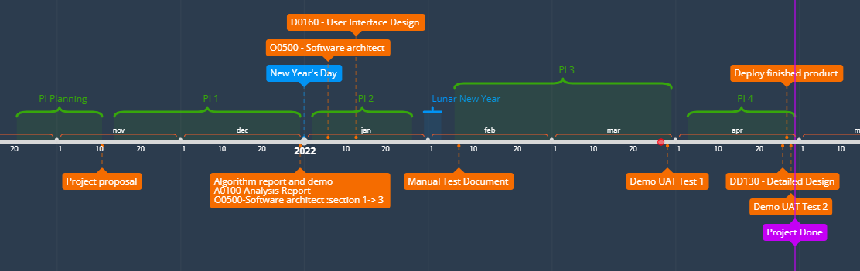
Plan
5

Slide 7

Plan - Completed Tasks
6
Up to now, we have already completed
Documents:
A0100 - Analysis Report (this also contains algorithm report): This report serves as a consolidation of Trading Vision Project (TVP) original requirements, the development team's proposal and the dialogue about every single requirement and acceptance criteria throughout the project timeline.

Slide 8
Plan - Completed Tasks
7
Documents:
O0500 - Software Architecture: The purpose of this document is to describe the software architecture i.e. which components are included in the solution, and how the components that have been developed as part of the Trading Vision Project (TVP) are designed and developed.

Slide 9
Plan - Completed Tasks
8
Documents:
D0160 - User Interface Design: The User-Interface Design documents the visual design of all pages on the Trading Vision Project (TVP). The document also describes the components used for each page, as well as the structural layout and navigational flow.

Slide 10
Plan - Completed Tasks
9
Documents:
Benchmarking Report: We evaluated the CPU performance as well as the length of time it takes to predict a stock. Create a cronjob to automatically predict stock price every day.

Slide 11

Plan - Completed Tasks
9
Data
Set up all necessary collections in MongoDB
Stock company information
Query for prediction
Stock prices
Predicting information
Reminders
Favorites
Users

Slide 12
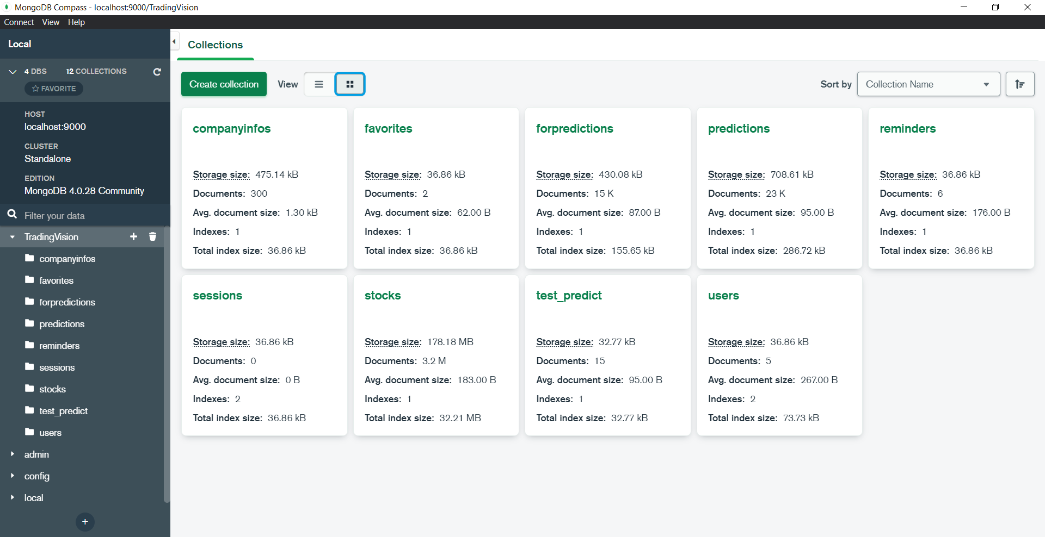
Plan - Completed Tasks
10

Slide 13

Plan - Completed Tasks
11
Website
What we complete:
All the website’s UI
Set up all necessary APIs for the website
Implement fundamental functions
The next video shows the demo of the web app

Slide 14
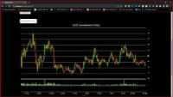
Plan - Completed Tasks
12
Website demo

Slide 15

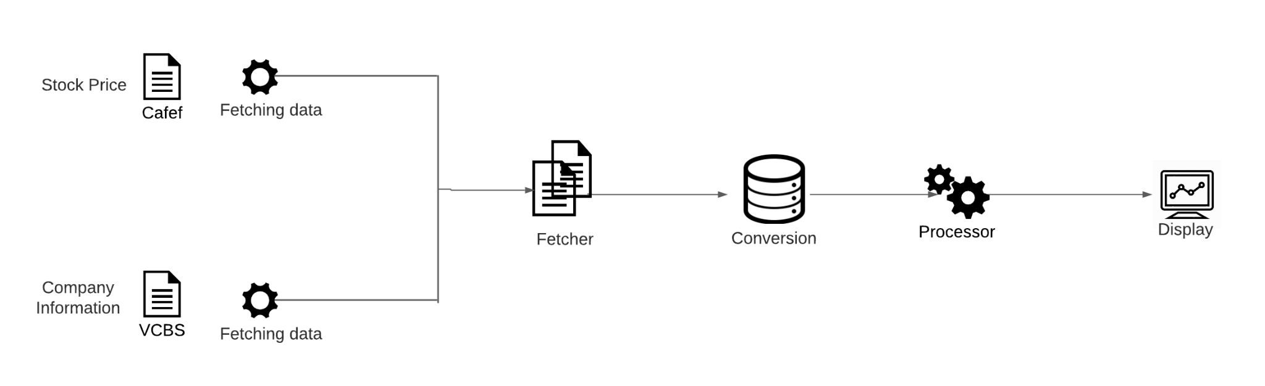
Plan - Completed Tasks
13
Fetch data:
Notes:
System gets data from two sources: CafeF for stock price and VCBS for company information. The retrieved data will be mapped to the database of system MongoDB in suitable schema. After that, those data will be pre-processed to prepare for the prediction phase afterwards. Finally, on the monitor of the users shows the chart according to the output of the prediction.

Slide 16
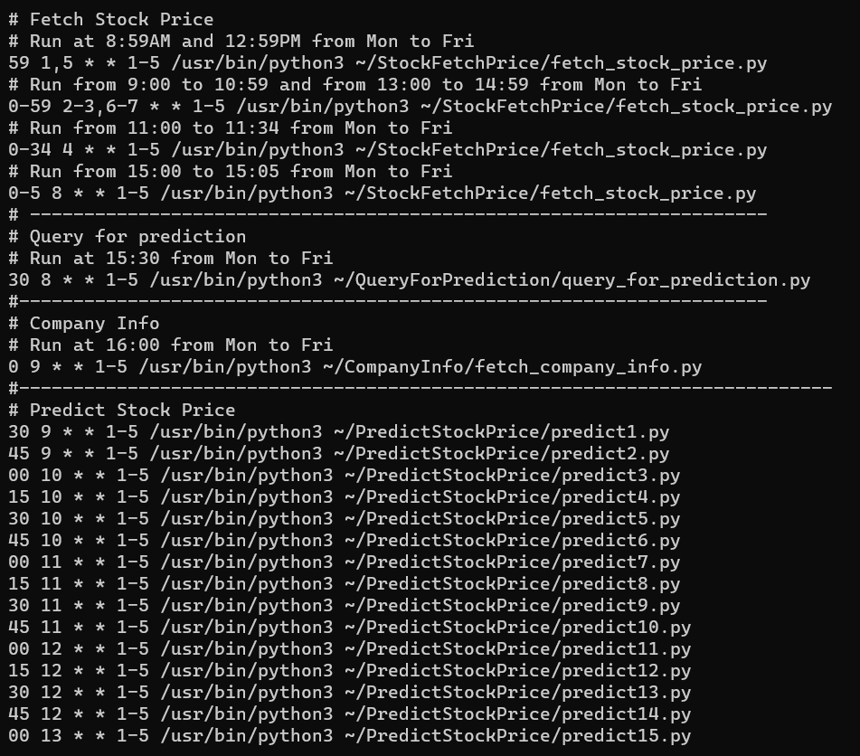
Plan - Completed Tasks
14

Slide 17
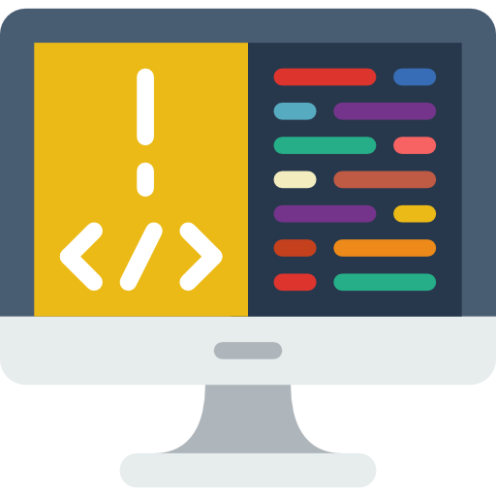
Plan - Remaining Tasks
15
Implementation:
Modify and improve API code in backend.
Fix some user interfaces:
Reminder edit forms
Increase the performance of the web app
Testing in website
Deploy the website

Slide 18

16
Evaluation

Slide 19

Evaluation
17
Up to now, we have:
Completed compulsory documents.
Stock prediction algorithm - LSTM.
Data to train our model, to display charts and other information in the User Interface.
MongoDB to store all necessary data.
A website for users to login, add reminder and favorite stock, see stock information, its candlestick chart and predicting line chart, have a comparison with another stock.

Slide 20

Evaluation
18
We need to improve and modify APIs, User Interfaces and deploy, testing the app. Nevertheless, with all above completed tasks and results, we are confident to accomplish them on the deadline.

Slide 21

Evaluation
19
Members did their assigned tasks on time, and drew from those a lot of experience.
Members updated progress everyday for team leader. Therefore, every issue is solved quickly.
Maintain weekly meeting at office with client for every Thursday to get feedbacks. Hence, team can modify plan appropriately.

Slide 22
Evaluation
20
Member Name | Logbook | Total Hours
Han Ngo Gia | Han's Timelog | 332 hours 27 minutes
Minh Quach Hoang | Minh's Timelog | 358 hours 21 minutes
Nguyen Nguyen Bao | Nguyen's Timelog | 375 hours 54 minutes
Thu Nguyen Vu Anh | Thu’s Timelog | 259 hours 35 minutes
Notes:
not finish

Slide 23
References
21
Status Report

Slide 24
THANK YOU FOR LISTENING!
Trading Vision Project (TVP)

